Slide 1
The International Convention on Liability and Compensation for Damage in Connection with the Carriage of hazardous and noxious substances by Sea, 1996 (HNS Convention)

Slide 2
background
HNS Convention was adopted by an IMO Conference in 1996.
A Protocol to amend the HNS Convention was adopted by an IMO Conference in 2010 – HNS Protocol 2010

Slide 3
PURPOSE
The HNS Convention establishes a global liability regime for compensation to victims who suffer damages arising from the carriage of HNS.
Two tier system of compensation:
TIER 1
Shipowner & the insurer
TIER 2
HNS Fund
System of compensation

Slide 4
What are hazardous noxious substances?
Defined under Article 1.5 of HNS Convention, as amended:
a) oils (bulk) – Annex 1 MARPOL
b) noxious liquid substances (bulk) Reg. 1.10 Annex II MARPOL
(e.g : Acetic acid/Acrylic acid/Ammonium nitrate solution)
c) dangerous liquid substances (bulk) IBC Code Chapter 17
(e.g : Turpentine/Xylenol)
d) dangerous, hazardous and harmful substances, materials and articles (packaged) IMDG Code (e.g : Class 1-9 except 7)
e) liquefied gases (bulk) IGC Code Chapter 19
(e.g : Butane/LNG/LPG/Propylene)
f ) liquid substances (bulk) flashpoint not exceeding 60°C
IBC Code (e.g : Methyl formate)
g) solid bulk IMSBC (e.g : Urea)

Slide 5
SCOPE OF CONVENTION
Covers all sea-going ships carrying HNS to, from, within Contracting States.
Apply to any damage in Malaysia, Malaysian Waters and Exclusive Economic Zone (EEZ).

Slide 6
SCOPE OF CONVENTION (cont.)
Damages covered:
a) Loss of life/personal injury (on board/outside the ship)
b) Loss or damage to property outside the ship, including evacuation costs.
c) Economic loss: Contamination (fishing/ mariculture/tourism)
d) Preventive measure: using boom to hold back oil or slowing the contamination
e) Reasonable measure of reinstatement of the environment e.g. replanting of mangroves
f) Clean up operations at sea and onshore

Slide 7
ENTRY INTO FORCE
HNS Convention will come into force 18 months following the date when:
a) Ratified by 12 states, four of which have no less than 2 million units of gross tonnage.
b) The volume of contributing cargo for the General Account must be at least 40 million tonnes.

Slide 8
TIER 1 SHIPOWNER’S LIABILITY & INSURANCE
Shipowner is liable for damaged caused by HNS at any time.
Strict liability: Shipowner is liable even he is not at fault in an HNS incident
Excludes acts of war, negligence or wrongful acts of public authorities, third parties or shippers of HNS.
Compulsory insurance:
- Approved insurers and certificates
- Examples: P&I

Slide 9
TIER 1(A) – LIMITS OF LIABILITY (BULK)
Ship Tonnage | Limit of Liability
Up to 2,000 GRT | 10 million SDR
2,001 – 50,000 GRT | 1,500 SDR per ton
More than 50,000 GRT | 360 SDR per ton
Note: Shipowner’s Maximum Limit is 100 million SDR

Slide 10
TIER 1(B) – LIMITS OF LIABILITY (PACKAGED)
Ship Tonnage | Limit of Liability
Up to 2,000 GRT | 11.5 million SDR
2,001 – 50,000 GRT | 1,725 SDR per ton
More than 50,000 GRT | 414 SDR per ton
Note: Shipowner’s Maximum Limit is 115 million SDR

Slide 11
Example of SHIPOWNER’S LIABILITY UNDER TIER 1
A ship of 30,000 GRT
Up to 2,000 GRT = 10 million SDR
30,000 GRT – 2,000 GRT = 28,000 GRT
So, 28,000 GRT x 1,500 SDR = 42 million SDR
Ship’s Limit of Liability -: (10 + 42) million = 52 million SDR
Or 52 million SDR x US$1.57 = US$81.64 million
*Refer Limit of Liability

Slide 12
TIER 2 – HNS FUND
HNS Fund is established under the HNS Convention.
Secretariat appointed to administer and manage the Fund.
Interim Secretariat is the IOPC Fund Secretariat based in London.

Slide 13
TIER 2 – HNS FUND
HNS Fund will pay compensation when the shipowner’s liability is insufficient to provide full compensation to the claimant(s).
Funding through contributions from HNS importers or receivers (international and domestic trade).
Only bulk HNS received are considered as “contributing cargo”
Packaged HNS are not included as contributing cargo.

Slide 14
TIER 2 –HNS FUND (cont.)
Four accounts for contributing cargo:
Account Annual Threshold (tonnes)
1) Oil Account* 150,000 persistent oils
20,000 non-persistent oils
2) LPG Account 20,000
(liquefied petroleum gas)
3) LNG Account Nil
(liquefied natural gas)
4) General Account 20,000
__________________________________________________________________________________________________________________________________________________________________________
* Excludes pollution damage caused by persistent oil covered under the 1992 Civil Liability Convention and 1992 IOPC Fund Convention

Slide 15
Example of calculation (tier 2) WHEN it IS ACTIVATED
HNS incident involving a ship of 30,000 GRT
Total damage caused by incident – 70 million SDR (amount claimed)
Tier 1:
Shipowner’s liability = 52 million SDR
Tier 2:
HNS Fund liability = 18 million SDR (i.e. the balance of claim amount)

Slide 16
HNS FUND ACCOUNTS
HNS Fund may have up to 4 accounts
Thresholds for activation of “Separate Accounts”
General Account : 40 million tonnes
Oil : 350 million tonnes
LNG : 20 million tonnes
LPG : 15 million tonnes
Each account is separate –no cross subsidy between accounts.
Collection of contributions is based on “post-event”.

Slide 17
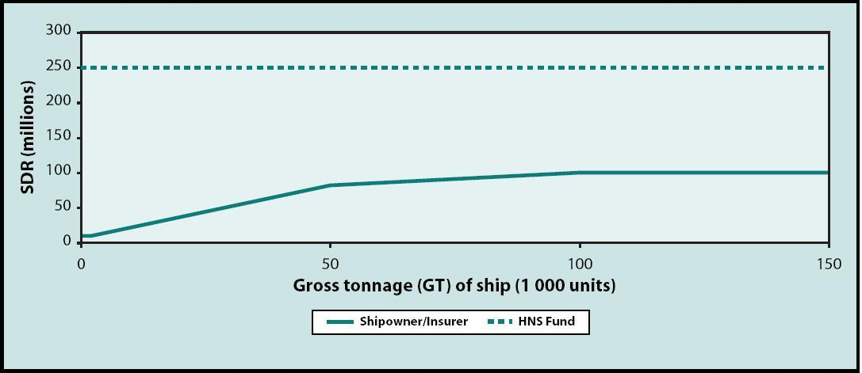
How much compensation will be available?
Shipowner’s liability: 10 - 100 million Special Drawing Rights (SDR) ($15.7 - $157 million)
The HNS Fund liability: maximum of 250 million SDR (USD392.5 million), including any amount paid by the shipowner and his insurer.

Slide 18
Reporting requirements Tier 2
Why?
To determine the actual receiver; the contributor to the HNS Fund
To determine the amount of HNS Cargo
To ensure Fund has sufficient funds

Slide 19
Who should report?
Physical receiver - person who physically receives contributing cargo
Principal receiver – owner of the cargo/physical receiver deemed as an agent
Must report to HNS Fund via Marine Department

Slide 20
PHYSICAL RECEIVERS
Port Authorities
Port Klang Authority
Kuantan Port Authority
Johor Port Authority
Terminal facilities owner/operator
North Port
Westports
Johor Port Berhad
Kuantan Port Consortium Sdn. Bhd.

Slide 21
principal RECEIVERS
Actual cargo owner
Felda storage
Petronas
Final receiver of HNS
Shell
Exxon Mobil

Slide 22
Reporting form
LUMUT MARITIME TERMINAL
2010 REPORT
LATEST : JAN - SEPT 2011

Slide 23
KUCHING PORT REPORTING FORM
PPC REPORTING FORM
KERTIH PORT SDN. BHD. REPORTING FORM

Slide 24
Scenario 1
CARGO
PHYSICAL RECEIVER
DESIGNATED PRINCIPAL
LIABILITY
Receiver based in State Party (port / terminal)
Principal based in a State Party
Principal is liable
HNS
LUMUT MARITIME TERMINAL (LMT)
PETRONAS DAGANGAN BHD
PETRONAS DAGANGAN BHD

Slide 25
Scenario 2
CARGO
PHYSICAL RECEIVER
DESIGNATED PRINCIPAL
LIABILITY
Receiver based in a State Party (port / terminal)
Principal based in a non-State Party
Agent (Physical Receiver)
HNS
LMT
X
LMT

Slide 26
Scenario 3
CARGO
PHYSICAL RECEIVER
DESIGNATED PRINCIPAL
LIABILITY
Receiver based in a State Party (port/terminal)
LNG titleholder if there is agreement
LNG titleholder
LNG
LMT
MLNG
MLNG
If NO agreement
LMT

Slide 27
Scenario 4
CARGO
PHYSICAL RECEIVER
DESIGNATED PRINCIPAL
LIABILITY
Receiver based in a non-State Party
Principal based in State Party
Convention does not apply :
No liability
HNS
X
PETRONAS DAGANGAN BERHAD
NOT APPLY

Slide 28
Hns incidents in malaysia
NO. | SHIP’S NAME | TYPE OF SPILL | LOCATION | DATE | INCIDENT CATEGORY | TOTAL SPILL (MT)
1. | Ing Hua Fu No.9 | Chemical Herbicides | Wharf 7, Southpoint, Port Klang | 18 October 2008 | Explosion and shipwrecked | 4.41
2. | MT Formosaproduct Brick | Naphtha | Tanjung Tuan, Negeri Sembilan | 18 August 2009 | Explosion | 58,000
* Resources from Department of Environmental (DOE)

Slide 29
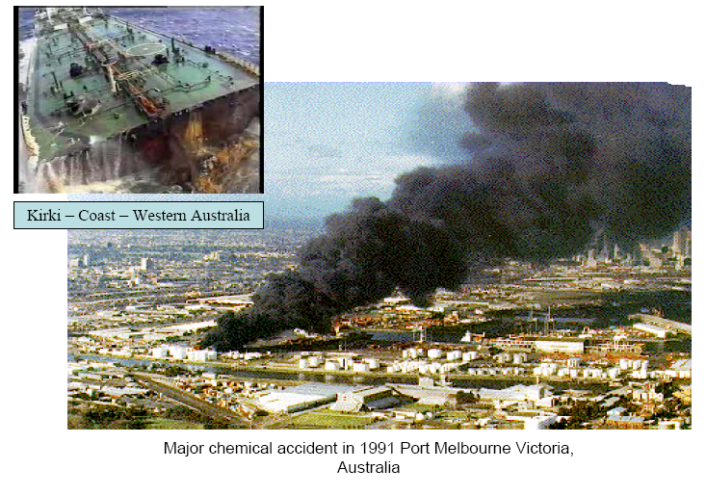
Hns incidents

Slide 30
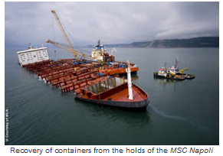
In 2007, the container ship MSC Napoli loaded with 42,000 tonnes of goods including HNS suffered structural failure at the entrance to the Channel. 103 containers fell into the water.

Slide 31
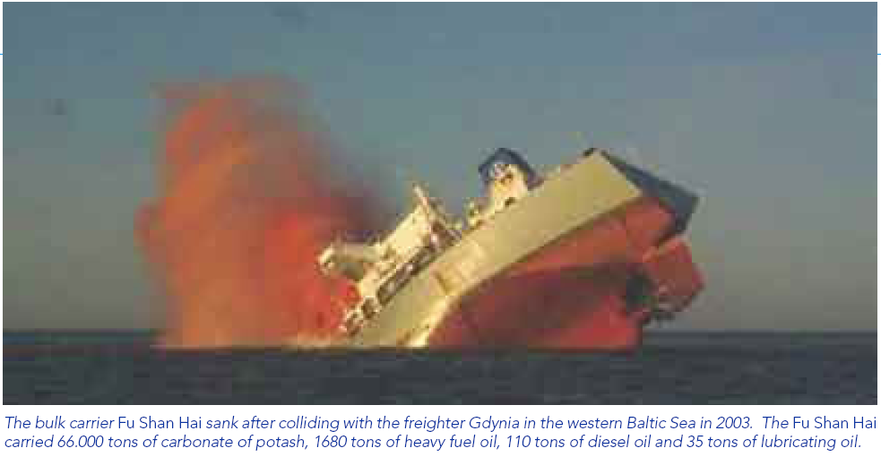

Slide 32
WEBSITES
www.hnsconvention.org
http://folk.uio.no/erikro/www/HNS/hns.html

Slide 33
CONTACTS
hnsconvention@marine.gov.my
Phone No.:
Rina Maslina Binti Baharudin 03 – 3169 5234
Norhafisol Bin Omar 03 – 3346 7740
Hafizah Binti Meor Osman 03 – 3347 7739
Mohd Arma Noramin 03 – 3169 5169

Slide 34
Thank you

