Slide 1
uCustoms Cargo and Declaration - Air Mode
Bilik Mesyuarat Kargo, Tingkat 1, Kompleks Kastam KLIA
9 Aug 2018
Notes:
The notes

Slide 2


OUTLINE
High Level Process Flows
Risk Management System (RMS) Channel
Import Journey & Manifest - Air
Export Journey & Manifest - Air
Import Declaration
Export Declaration
Q & A

Slide 3






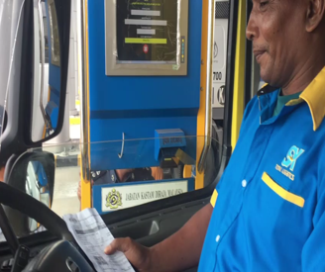


High Level Process Flow (Import)
RBA & Licensing
Permit, PTT, Exemption etc
Journey
Manifest
Declaration
RMS
RBA & LICENSING
PERMIT, PTT, EXEMPTION etc
CARGO
DECLARATION
RMS
Clearance & Release
Payment
Assessment
Inspection
CLEARANCE & RELEASE
PAYMENT
ASSESSMENT
INSPECTION
Baharu dalam sistem uCustoms

Slide 4
High Level Process Flow (Export)
RBA & Licensing
Permit etc
Journey
Shipment Order
Declaration
RMS
RBA & LICENSING
PERMIT, EXEMPTION etc
CARGO
DECLARATION
RMS
Manifest
Clearance & Release
Payment
Assessment
Inspection
CARGO
CLEARANCE & RELEASE
PAYMENT
ASSESSMENT
INSPECTION
Baharu dalam sistem uCustoms

Slide 5
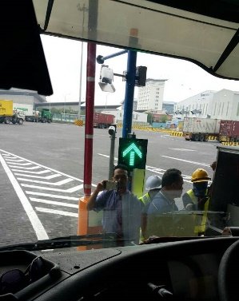

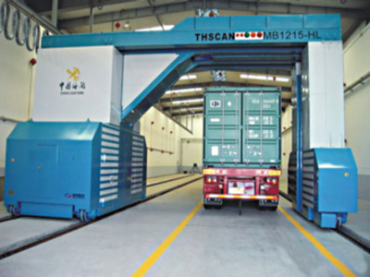
RMS Channel
Green Channel
Goods declared obtains an automatic customs clearance of the goods declared (85% of current declaration statistics)
Yellow Channel
Goods declared will undergo examination of the import/export documents
Red Channel
Goods declared will undergo physical examination as well as examination of the import/export documents

Slide 6

3
Import Journey & Manifest (Air)

Slide 7

End To End - High Level Process Flow for Import
Registration
Single Sign-On
Register as uCustoms User
Internal/
External Users
Cargo
Register Foreign Vessel
Submit Journey
Arrive Journey
Submit FOT
Airport Authority
Register Flight Details
Submit Import Manifest (AWB/
MAWB+HAWB)
Integration/Direct Input
RMS
Terminal Operator
NOC
Go to Declaration
(Direct Input only)
Customs Agent
Submit HAWB

Slide 8
4
Export Journey & Manifest (Air)

Slide 9
End To End - High Level Process Flow for Export
Registration
Mit
Single Sign-On
Register as uCustoms User
Internal/
External Users
Cargo
Airport Authority
Auto Created Export Journey/
Submit Export Journey
Assign Slot Chartered Agents
Depart Journey
Submit SOC
Issue Shipment Order
Go to Declaration
Submit Export Manifest (AWB/MAWB+HAWB)
RMS
Terminal Operator

Slide 10
5
Import Declaration

Slide 11
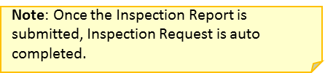
End To End - High Level Process Flow for Import
Declaration
Create Import Declaration
Create Invoice
Create Invoice Items
Calculate Duty
Submit Declaration
AWB & Journey No
Permit, Exemption,
PTT etc.
RMS
Trader/
Forwarding Agent
Submit Appointment
Go to Assessment
Go to Payment/
Release
View Declaration Dashboard
Inspection
Approve Appointment
Open Inspection Request
Associate SIAT Members List
Assign Inspection Request
Complete Inspection Request
Inspector Supervisor
Accept Inspection Request
Create Inspection Report
Submit Inspection Report
SIAT Member

Slide 12
End To End - High Level Process Flow for Import
Assessment
Open Assessment Request
Assign Assessment Request to Verification Supervisor (self)/Officer
Verification Supervisor
Accept Declared Value
Complete Item Assessment
Recalculate Duty
Complete Assessment
Verification Supervisor/Officer
Accept
Note: Bill is generated
Trader/
Forwarding Agent
Payments
Open Auto Generated Bill
Create Payment with Online Payment option
Create Payment Transaction(s) with FPX/JomPay
Submit Payment
Payment Collected Online
Trader/
Forwarding Agent
Go to
Clearance & Release

Slide 13
End To End - High Level Process Flow for Import
Clearance & Release
Create Gate Pass & Gate Pass Details
Associate Declarations
Submit Gate Pass Details & Gate Pass
Go to Auto Gate System (AGS)
Auto Release
Trader/
Logistic Company
Note: AGS
Print Gate Pass
View Declaration Dashboard
Note: No AGS
Terminal Operator Approval
Note: Integration/Direct Input
Terminal Operator
Approve and Issue Gate Pass
Manually Release
CEA Officer
Note: Scan using Handheld/
Direct Input to the system

Slide 14
6
Export Declaration

Slide 15
End To End - High Level Process Flow for Export
Declaration
Create Export Declaration
Create Invoice
Create Invoice Items
Calculate Duty
Submit Declaration
AWB & Journey No
Permit, Exemption etc.
RMS
Trader/
Forwarding Agent
Go to Assessment
Go to Payment/
Clearance & Release
View Declaration Dashboard
Submit Appointment
Inspection
Approve Appointment
Open Inspection Request
Associate SIAT Members List
Assign Inspection Request
Complete Inspection Request
Inspector Supervisor
Accept Inspection Request
Create Inspection Report
Submit Inspection Report
SIAT Member

Slide 16
End To End - High Level Process Flow for Export
Assessment
Open Assessment Request
Assign Assessment Request to Verification Supervisor (self)/Officer
Verification Supervisor
Accept Declared Value
Complete Item Assessment
Recalculate Duty
Complete Assessment
Verification Supervisor/Officer
Accept
Trader
Note: Bill is generated
Payments
Open Auto Generated Bill
Create Payment with Online Payment option
Create Payment Transaction(s) with FPX/JomPay
Submit Payment
Payment Collected Online
Trader
Go to
Clearance & Release

Slide 17
End To End - High Level Process Flow for Export
Clearance & Release
Create Gate Pass & Gate Pass Details
Associate Declarations
Submit Gate Pass Details & Gate Pass
Go to Auto Gate System (AGS)
Auto Release
Trader/
Logistic Company
Note: AGS
Print Gate Pass
View Declaration Dashboard
Note: No AGS
Terminal Operator Approval
Note: Integration/Direct Input
Terminal Operator
Approve and Issue Gate Pass
Manually Release
CEA Officer
Note: Scan using Handheld/
Direct Input to the system

Slide 18


Slide 19
Thank You

