Slide 1

Briefing on Updated Status of uCustoms at Johor
15th August 2018

Slide 2
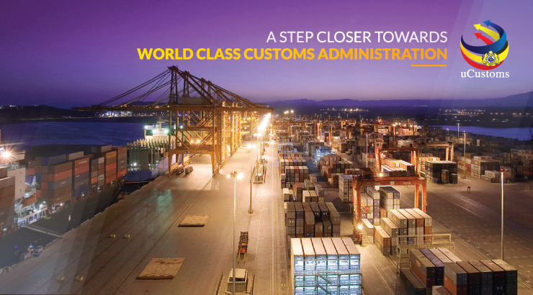
AGENDA
Development Method According to Release 1 until Release 5
uCustoms Release 3 Current Status
Pilot Port Klang
Achievement Engagement and Training at Port Klang
Challenges and Impacts

Slide 3
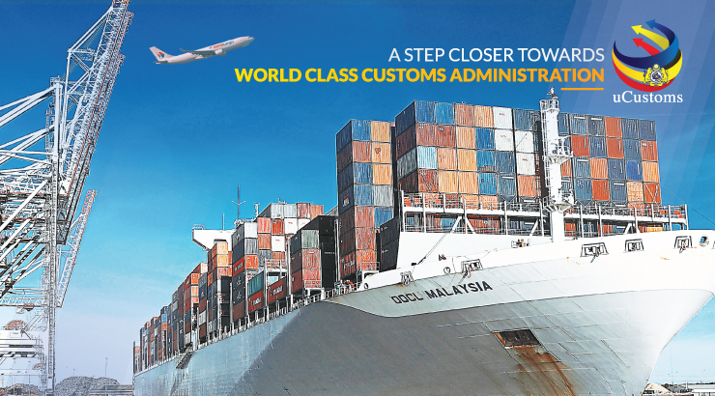
1
Development Method According to Release 1 until Release 5

Slide 4

uCustoms as a Whole
uCustoms Project
Involves various parties
Initiatives led by the Malaysian Government
Need an intensive time
The Releasing process is quick and easy
Automation and cost savings
Aims to unify multiple systems and processes onto one platform
Fingertips, anytime, anywhere, any device
Cross Borders Regulatory Agencies (CBRA)
Trade community
No process manually
Cost Savings
Design various processes affecting different parties
Take into account holistic needs
Provide consistent operating procedures throughout Malaysia

Slide 5

Value Added in uCustoms
Manifest
Pre arrival Manifest
Self Declaration
Self declaration and assessment
Embedded Integrated Tariff
Appoint Agents or Service Providers
Integrated system with selected agencies
Risk Assessment
Risk Management System driven
Code: Red, Yellow and Green
Duty Payment
Online payment
No payment counters except for Passengers
Physical Release
Using the QR code pass gates
Physical inspection using online appointment
Physical inspections via SIAT ( Single Inter-Agency Taskforce)
24 hours before arrival by Sea
2 hours before arrival by Flights

Slide 6
System Delivery Approach
Big Bang
Released
Delivery changed from Big Bang to Released Approach, comprising of 5 release and 1 Supporting Application Delivery and Implementation

Slide 7

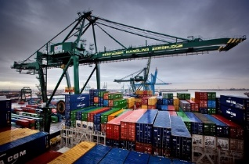




Implementation of uCustoms By Release
17th Mac 2017
15th July 2017
30th October 2017
31st March 2018
30th June 2018
30th October 2018
Pilot End to End Clearance All Scenarios
Sea: All Traders, Selected Location
Air : All Traders, Selected Location
Land : Selected Traders (JOHOR BAHRU, PADANG BESAR)
Acceptance Port Clearance:
Enforcement, Legal Affairs (Relevant Scenarios)
Port Clearance Audit:
End-to-End Scenarios
Rollout:
End to End Clearance
Sea, Air and Land Mode
Port Clearance:
Audit, Enforcement and Legal Affairs
Permit Module for 28 agencies on NSW myCOO
ALL TRADERS, ALL LOCATION
SUPPORTING APPLICATION
CRs with no sign off requirements
Mobile Application –
Auto-gate, passenger assessment, mobile generic
MIS – 10 reports per module
Business Intelligence
Selected Severity 5 IRs
Pilot Registration of users and Agents
WESTPORT
Pilot Sea Mode:
End to End Clearance for Normal Import Export – Selected Scenarios
Selected Traders
Selected Location : WEST PORT
Pilot Sea Mode:
End to End Clearance for All Scenarios – All Traders and Selected Location:
WEST PORT, NORTH PORT, SOUTH PORT
Pilot Air Mode
End to End Clearance
Selected Scenarios
Selected Traders
Selected Location : KLIA, KLIA2, PENANG, SUBANG
RELEASE 1
RELEASE 2
RELEASE 3
RELEASE 4
RELEASE 5

Slide 8
1 Scenario Involved in Release 1
17th Mac 2017
Pilot Registration of users and Agents
WESTPORT
1. Registration
RELEASE 1

Slide 9
Registration Statistics for Release 1 & 2
SELANGOR SHIPPING AGENTS AS PER 7 MAY 2018
Unregistered | 21.2 | 47
Registered | 78.8 | 175
Total SA | 100 | 222

Slide 10
Registration Statistics for Release 1 & 2
SELANGOR FORWARDING AGENTS AS PER 7 MAY 2018
Unregistered | 10.7 | 50
Registered | 89.3 | 417
Total FA | 100 | 467

Slide 11
Registration Statistics for Release 1 & 2
SELANGOR DIRECT USER AGENTS AS PER 7 MAY 2018
Unregistered | 33.1 | 48
Registered | 66.9 | 97
Total DUA | 100 | 145

Slide 12
14 Scenarios Involved in Release 2
15th July 2017
1. Manifest submission (Ship Clearance (Vessel Reg.) + Cargo)
2. Import - With permit, no exemption
3. Import - With permit, with exemption
4. Import - No permit, no exemption, non-dutiable
5. Import - No permit, with exemption, non-dutiable
Pilot Sea Mode:
End to End Clearance for Normal Import Export – Selected Scenarios
Selected Traders
Selected Location : WEST PORT
RELEASE 2
6. Import - No permit, no exemption, dutiable (with payment)
7. Import - No permit, with exemption, dutiable (with payment)
8. Import - No permit, with exemption, dutiable (with payment) and Surety for License Generic
9. Export - With permit, no exemption
10. Export - With permit, with exemption
11. Export - No permit, no exemption, non-dutiable
12. Export - No permit, with exemption, non-dutiable
13. Export - No permit, no exemption, dutiable (with payment)
14. Export - No permit, with exemption, dutiable (with payment)

Slide 13














OGA/PIA
Service Provider (SP)
Stakeholders
DNT
EDARAN
Royal Malaysian Customs Department (RMCD)
Port Operator
Port Authority
Jabatan Laut Malaysia (JLM)
Bank
Users
Hauliers
Shipping Agent
Freight Forwarding Agent
Forwarding Agent
Traders

Slide 14
2
uCustoms Release 3 Current Status

Slide 15
Scope on Release 3 - Modules
30th October 2017
Registration
(Port)
Broker Affairs
Licensing
(Port)
Cargo
(Manifest,
Tracking)
Ship Clearance System (SCS)
Integrated Tariff - Exemptions
Assessment
Inspection
Declaration (Import, Export)
Pilot Sea Mode:
End to End Clearance for All Scenarios – All Traders and Selected Location:
WEST PORT, NORTH PORT, SOUTH PORT
Pilot Air Mode
End to End Clearance
Selected Scenarios
Selected Traders
Selected Location : KLIA, KLIA2, PENANG, SUBANG
Surety
Permit Management
Integrated Tariff Management
(Classification)
Accounting
(Billing)
Integrated Tariff - Rulings and Appeals
Financial Accounting System (FAS) - General Ledger (GL)
FAS - Accounts Payable (AP)
Resource Planning
Payment
RMS - Cargo Targeting System (CTS)
(Profiling)

Slide 16
Scope on Release 3
11 Scenarios
29 Agencies
16 Permit Types
Various Internal & External Stakeholders
11 Integration Points

Slide 17
11 Scenarios Involved
1. Ship Clearance Module
2. Cargo Module – SEA Mode with General Compound
3. Sea Import (K1 source BL) – with or without Permit and with AEO status
4. Sea Import (K1 source BL) – with Permit and CBRA Approval and quota
5. Sea Import (K1 source BL) – Dutiable, with Permit, License to use jetty plus anti-dumping duties
6. Sea Import (K1 source BL) – Dutiable, with Permit plus safeguard duties
7. Sea Import (K1 source BL) – Dutiable with MIDA Exemption
8. Sea Import (K1 source BL) – Dutiable with Treasury Exemption (MOF)
9. Sea – Transit DMP6 (Daftar Muatan Pindah) between ports (Northport, Westport)
10. Sea – Transit K8 import (run inbound first the outbound for warehouse)
11. Sea – Transit K8 Export (run inbound first then outbound for warehouse)

Slide 18
Agency that Involved in Release 3 (PIA)
Hazardous Substances Division, Department of Environment (DOE)
National Solid Waste Management
Malaysian Pineapple Industry Board (MPIB)
Department of National Heritage (DONH) - Peninsular

Slide 19
Agency that Involved in Release 3 (PIA)
Construction Industry Development board (CIDB)
International Marketing Division, National Kenaf and Tobacco Board

Slide 20

Agency that Involved in Release 3 (OGA)
Marine Department Malaysia
Pesticides Control Division, Department of Agriculture Malaysia (DOA)
Paddy and Rice Industry Division, MOA

Slide 21



Agency that Involved in Release 3 (OGA)
Pharmaceutical Services Division, Ministry of Health
Food Safety and Quality Division of the Ministry of Health (MOH)
Malaysian Quarantine and Inspection Services (MAQIS)
The Text Publication and Quranic Text Control Division, Ministry of Home Affairs

Slide 22

Agency that Involved in Release 3 (OGA)
Commissioner of Heritage (Peninsular)
Ministry of Domestic Trade, Co-operative and consumerism (KPDNKK)
Department of Veterinary Services (DVS)
Air Division, Department of Environment (DOE)

Slide 23




Agency that Involved in Release 3 (OGA)
Plant Biosecurity Division, Department of Agriculture (DOA)
Fisheries Development Authority of Malaysia (LKIM)
Department of Fisheries (DOF)
Ministry of International Trade and Industry (MITI)

Slide 24




Agency that Involved in Release 3 (OGA)
Department of Wildlife and National Parks
Malaysian Palm Oil Board
Malaysia Rubber Board
Ministry of Finance (MoF) – gaming machines

Slide 25




Agency that Involved in Release 3 (OGA)
Federal Agriculture Marketing Authority Peninsular (FAMA)
Malaysian Timber Industry Board (MTIB)
Lands and Mines Office, Ministry of Natural Resources and Environment (NRE)
Ministry of Domestic Trade, Co-operative and consumerism (Toys and Primary Battery) - KPDNKK

Slide 26
Permit Types / Names
Import Permit for Scheduled Wastes
Export Permit for Scheduled Wastes
Import Clearance Letter for Non-Scheduled Wastes (Chemical)
Import Clearance Letter for Non-Scheduled Wastes (Others)
Import Clearance Letter for Non-Scheduled Wastes (Used Electrical and Electronics Engineering (EEE))
Export Clearance Letter for Non-Scheduled Wastes (Chemical)
Export Clearance Letter for Non-Scheduled Wastes (Others)
Export Clearance Letter for Non-Scheduled Wastes (Used EEE)
Import Permit of Registered Pesticides
Import Permit for Education & Research:
Analytical Standard
Sample for registration
Sample of research
Certificate of Approval (Import)
Certificate of Approval Exemption (Import)

Slide 27
Permit Types / Names
Import Permit HCFC for DOE Air Division
Export Permit HCFC for DOE Air Division
Import Permit (AP) for National Solid Waste Management
Export Permit for Department of National Heritage (DONH) - Peninsular

Slide 28
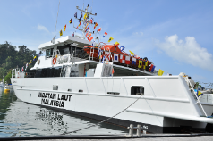

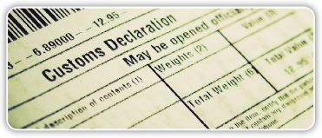

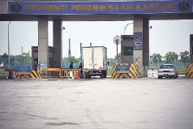
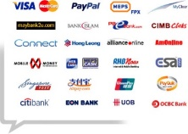

Stakeholders Involved
VESSEL REGISTRATION
MANIFEST SUBMISSION
DECLARATION SUBMISSION
ASSESMENT
INSPECTION
PAYMENT
RELEASE
END TO END CLEARANCE PROCESS 11 SCENARIOS

Slide 29
Key Features
Pre-Arrival Declaration
Pre-Arrival Clearance
Online Payment
Integrated Permit
Online Appointment Setting
Self Duty Assessment
Multiple Agency Inspection by a Single Team (SIAT)
Centralized Clearance Process (NCC)
Standardized Ship Clearance Number (SCN)

Slide 30
Integration Points
uCustoms
RMS
BNM (Exchange Rate)
JLM (Registered Local Vessel)
Port Operator (Westports)
Autogate
FAS
FPX
JomPAY
BNM (Outbound CUSDEC)
Matrade (Outbound CUSDEC)
DOSM (Outbound CUSDEC)

Slide 31
3
Pilot
Port Klang

Slide 32
Pilot Port Klang
01/05
18/05
01/06
R3 Application Readiness, Testing and Production Deployment
uCustoms R1, R2 and R3 System Ready
R3 Engagement & uCustoms Readiness Briefing
R3* System Training
uCustoms Go Live 1st June 2018 Port Klang
R3 Readiness of User Guide, SOP & Training Material
R3 Training Kastam Negeri,
Opera t I on
Ready
Engagement and Training PIA
Engagement with AFAM
R3 Training to Kastam HQ (NCC, CCC, BTM,PERTEK)
Engagement With Port Operators and Port Authority
Engagement with SAM & FF Community
R3 Training to Westport, Northport and LPK
Engagement and Training for OGA
Engagement with FA/Traders
R3 Training SAM & FF
R3 Training SAM & FF Session 2
Identification of Pilot Stakeholders for R3
Engagement with SP
R3 Training to FF/SA
R3 Training to FF/SA Session 2
Operational Briefing to Stakeholders
R3 Training to FA & Traders
R3 Training to FA / Traders Session 2
Awareness Notices for Registration, and Usage of uCustoms at Port Klang
R3 Training to Hauliers
R3 Training to Haulier Session 2
Continuous Registration of Stakeholders in uCustoms
System Ready for Go-Live
*R3 Training may covers the New CR and R3 Modules on Manifest, Declaration, FAS and Payments

Slide 33
4
Achievement
Engagement and Training
at Port Klang

Slide 34
Port Klang Go-Live Completed Engagement Session
No | Engagement Session | Proposed Date | Remarks
1. | Engagement with JLM (Registration Master/Normal User ) | 27th April 2018 | MKN, Cyberjaya
2. | Engagement with Port Operator (Registration Master/Normal User ) | 21st April 2018 | Northport
3. | Engagement with SAM members (Registration Session ) | 3rd May 2018 | MKN, Cyberjaya
4. | Engagement for OGA (6 Agencies SIAT) | 4th May 2018 | Wisma Kastam Selangor
5. | Engagement and Training for OGA/PIA | 21st May 2018 | NCC, Cyberjaya
6. | Engagement and Training with AFAM | 23th May 2018 | Wisma Kastam Selangor
7. | Engagement and Training with SFFLA Session 4 | 23th May 2018 | Pejabat SFFLA
8. | Engagement and Training with Forwarding Agents | 22th May 2018 | Wisma Kastam Selangor
9. | Engagement and Training with Shipping Agents | 24th May 2018 | Wisma Kastam Selangor
10. | Engagement and Training with Traders (Direct Users) | 25th May 2018 | Wisma Kastam Selangor
11. | Engagement Freight Forwarder & Haulier | 25th May 2018 | Wisma Kastam Selangor
Session completed

Slide 35
Port Klang Go-Live Completed Demo Session
No | Training Session | Proposed Date | Remarks
1. | Operation Training to BTM and CCC ( High level architecture, Server) | 21th May 2018 | Data Center, Wisma Kelana Jaya
2. | R3 Training OGA/PIA | 21st May 2018 | Cyberjaya
3. | R3 Training to Kastam Kastam Negeri Selangor (CEA, Related Officers) | 30th May 2018 | Kastam Selangor
4. | R3 Simulation Training to OGA / PIA | 25th May 2018 | Cyberjaya
5. | R3 Go-Live Training to Westport, Northport, Asaniaga and LPK | 30th May 2018 | Westport
6. | R3 Go-Live Training to Selected Traders | 31st May 2018 | Kastam Selangor
7. | Training session with Forwarding Agent (Day 1) | 5th June 2018 | MKN, Cyberjaya
8. | Training session with Forwarding Agent (Day 2) | 6th June 2018 | MKN, Cyberjaya
9. | Internal Training Session For Mentor | 7th June 2018 | MKN, Cyberjaya
10. | Internal Training Session For CEA | 8th June 2018 | MKN, Cyberjaya
11. | Internal Briefing Session on uCustoms Go-Live for Air Mode in Subang Airport | 8th June 2018 | MKN, Cyberjaya
12. | Registration Session for PIA | 11th June 2018 | MKN, Cyberjaya
Session completed

Slide 36
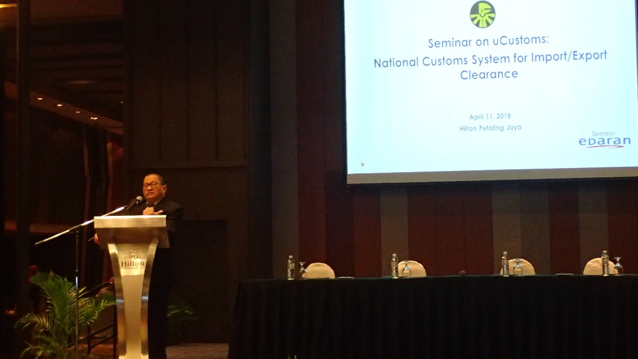
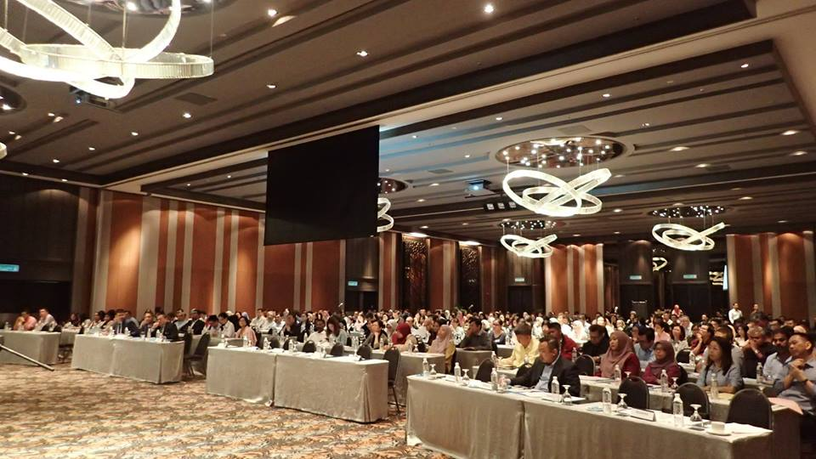
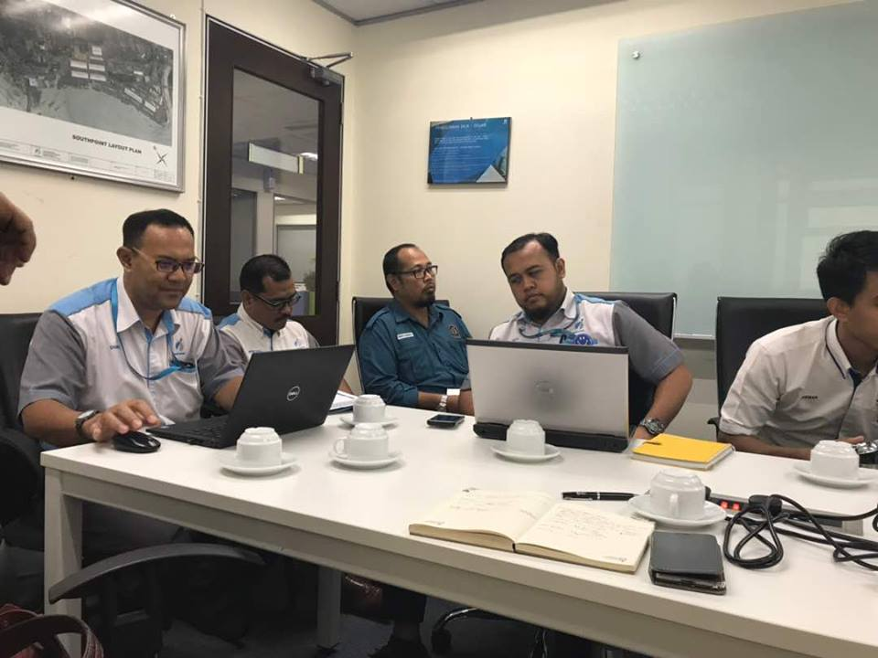
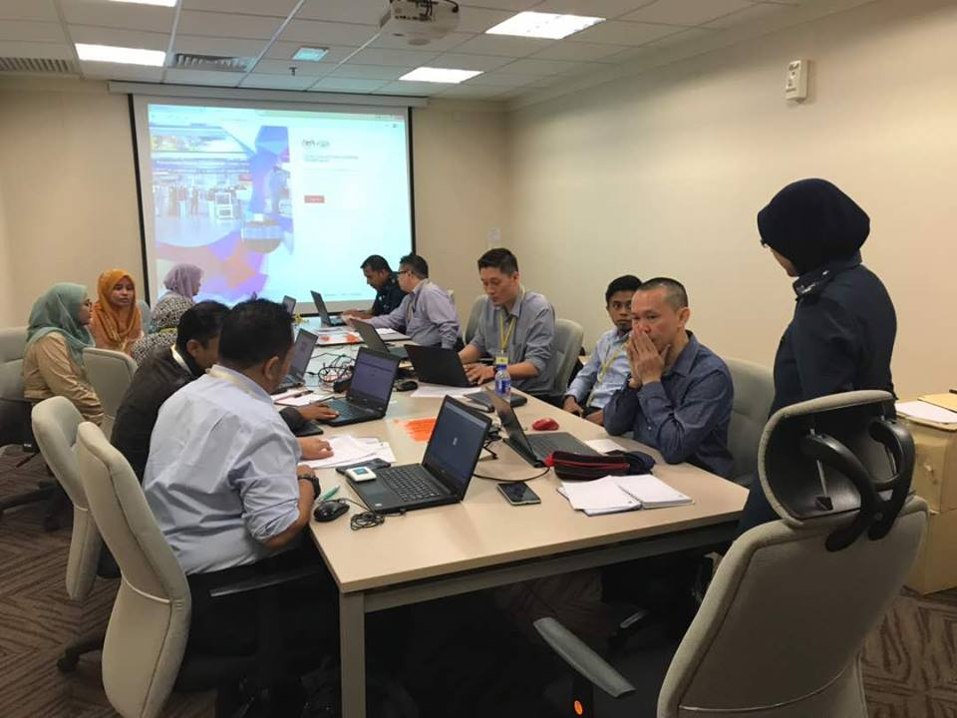
Achievement Memories

Slide 37
5
Challenges and
Impacts

Slide 38
Challenges and Impacts
Significant New Operational Requirement
Commitment from External Stakeholders
Stakeholder Readiness
Unforeseen operational gap after R3 Go Live 13.12.2017
Poor Participation in engagement programme
Sense of ownership of stakeholders
Significant time and changes required to accommodate new requirements and “wish lists” after UAT
Insufficient Resources
Requires significant customization and Effort
Resulted
Resulted
Required heavy customisation
Increased in development period and man-power
Low usage
Resistance from Business Communities
Low usage
Resistance from Key Stakeholders

Slide 39
Thank You

