Slide 1
IMPLEMENTATION OF
RELEASE OF IMPORTATION OF GOODS UNDER THE GOODS & SERVICES TAX (GST) (ZERO-RATED SUPPLIES) ORDER 2014
Outreach Program by Royal Malaysian Customs Department
Date : 17 March 2017

Slide 2

CONTENTS
INTRODUCTION
SCOPE OF IMPLEMENTATION
IMPLEMENTATION ACTION

Slide 3
INTRODUCTION
In general, all goods imported into Malaysia will be subjected to the Goods and Services Tax (GST) at a standard rate (6%) as specified in the Goods and Services Tax Act 2014
Based on the paragraph 3, in the Goods and Services Tax (Relief) Order 2014, any person who imports the goods specified in the First Schedule to the Goods and Services Tax (Zero Rated Supplies) Order 2014 [PU (A) 272/2014] is granted exemption from payment of GST Import

Slide 4
SCOPE OF IMPLEMENTATION
This implementation involves only declarations of goods under the First Schedule of the Goods and Services Tax (Zero Rated Supply) 2014
Effective 1 April 2017, the Royal Malaysian Customs Department has established a Relief Code (Relief Order Code) 'P03' to meet the needs of GST zero-rated goods declaration to be included by declarants in the Customs Declaration

Slide 5
IMPLEMENTATION ACTION
The impacted Customs declarations K1, K8 and K9. For any imported goods fall under the First Schedule to the Goods and Services Tax (Zero Rated Supplies) Order 2014 [PU (A) 272/2014] Paragraph 3, declarants are required to capture the following information
GST Treatment Type | R (for GST Relief Order)
GST Treatment Reference No. | P03 (for Preamble Paragraph 3, GST Relief Order P.U. (A) 273/2014)

Slide 6
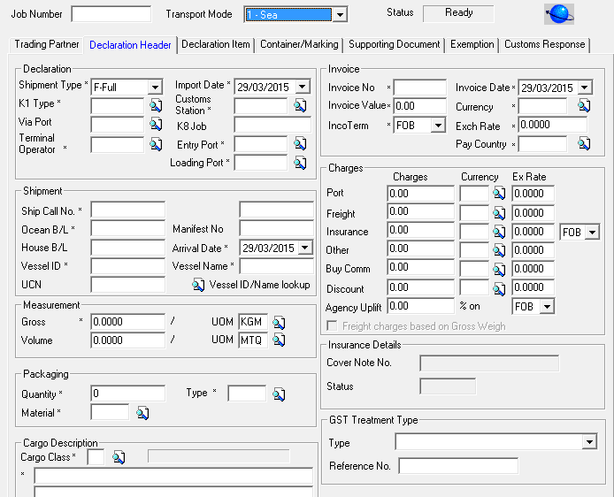
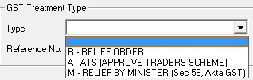
IMPLEMENTATION ACTION
GST TREATMENT TYPE
Declaration Header
GST Treatment Type [R/A/M]
Type | Ref No
R | GST Relief Order with 3 char alphanumeric
A | Approve Trader Scheme with 13 chars alphanumeric
M | Relief by Finance Minister with 35 chars alphanumeric

Slide 7
IMPLEMENTATION ACTION
GST Treatment Reference No.
Declaration Header
GST Treatment Reference No.
P03
(for Preamble
Paragraph 3, GST
Relief Order P.U. (A)
273/2014)

Slide 8
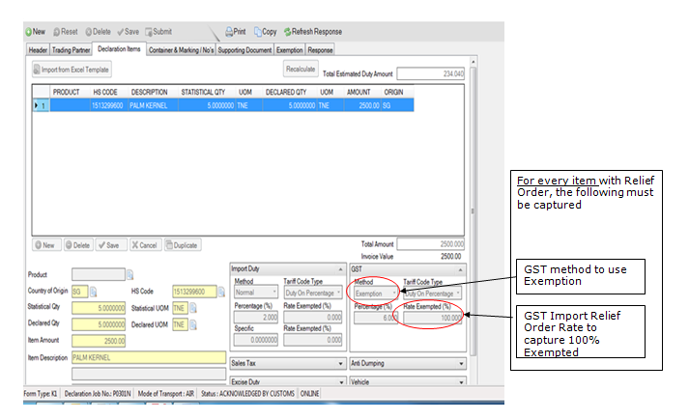
IMPLEMENTATION ACTION
Declaration Items

Slide 9
IMPORTANT NOTICE
Usage of non certified front end software by unauthorized partners, please be reminded of the following possible implications that may incur during this implementation;
Non compliance to authorities’ latest regulation and requirement
Possibility of goods being halted at arrival ports resulting in demurrage charges
Limited support services from Dagang Net Technologies

Slide 10
Thank You
For further assistance, please contact Careline at: 1300133133 or email:careline@dagangnet.com
Dagang Net Technologies Sdn Bhd (177974-T)
Tower 3, Avenue 5, The Horizon Bangsar South, No 8 Jalan Kerinchi, 59200 Kuala Lumpur.

